Slide 1
Artificial Intelligence
3rd year, 1st semester
”Science is the belief in the ignorance of experts.” Richard Feynman
Lecture teachers:
Ionuț Cristian Pistol
E-mail: ionut.pistol@info.uaic.ro
Mădălina Răschip
E-mail:madalina.raschip@info.uaic.ro
Lab teachers:
Laura Cornei
E-mail: laura.cornei@info.uaic.ro
Diana Trandabăț
E-mail: diana.trandabat@info.uaic.ro

Slide 2
Course information
Timetable
Course webpage
Discord server
Evaluation:
Points given for project tasks (4) and written tests (3) at seminars(4 X 1 + 3 X 2 = L, maximum 10).
Project (PP, maximum 10).
Written exam (E, maximum 10).
Bonus points for course and lab activity (B).
Grades are given using the formula ROUND(L*0.4 + PP*0.2 + E*0.4 + B). To pass you need E at least 5 and final score of at least 4.5.

Slide 3
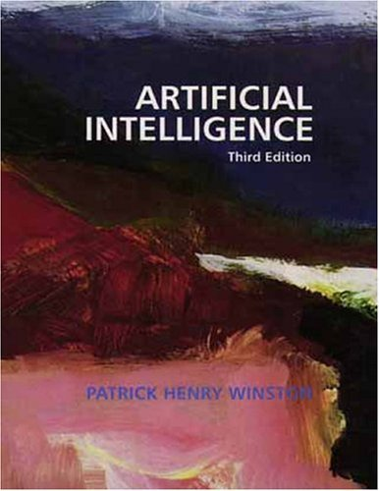
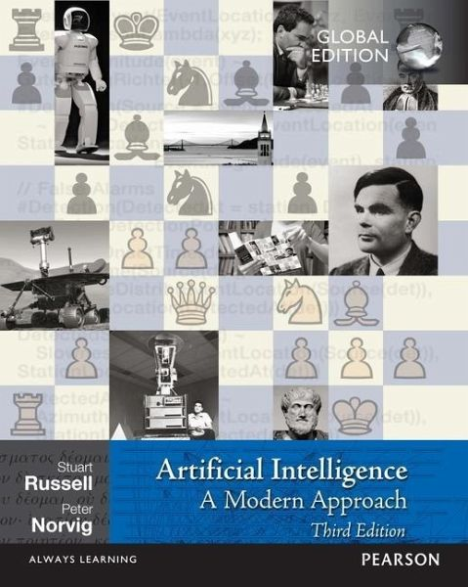
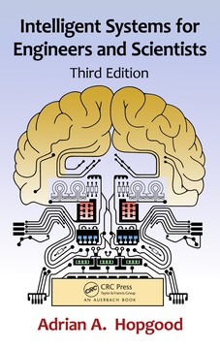
Bibliography

Slide 4


Related course materials
CS221: Artificial Intelligence: Principles and Techniques
Lecture Videos | Artificial Intelligence | Electrical Engineering and Computer Science | MIT OpenCourseWare

Slide 5
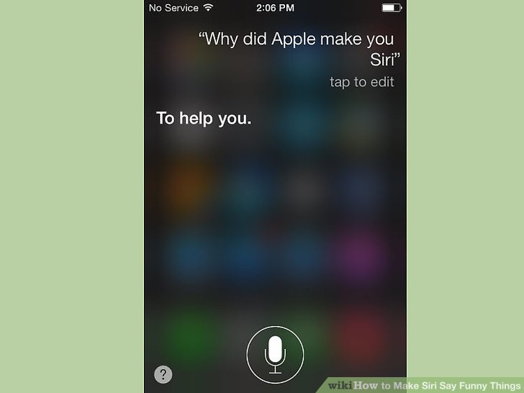

Defining Artificial Intelligence
Artificial Intelligence: Wikipedia, Britannica, Merriam-Webster
Intelligence: Wikipedia, Britannica, Merriam-Webster

Slide 6
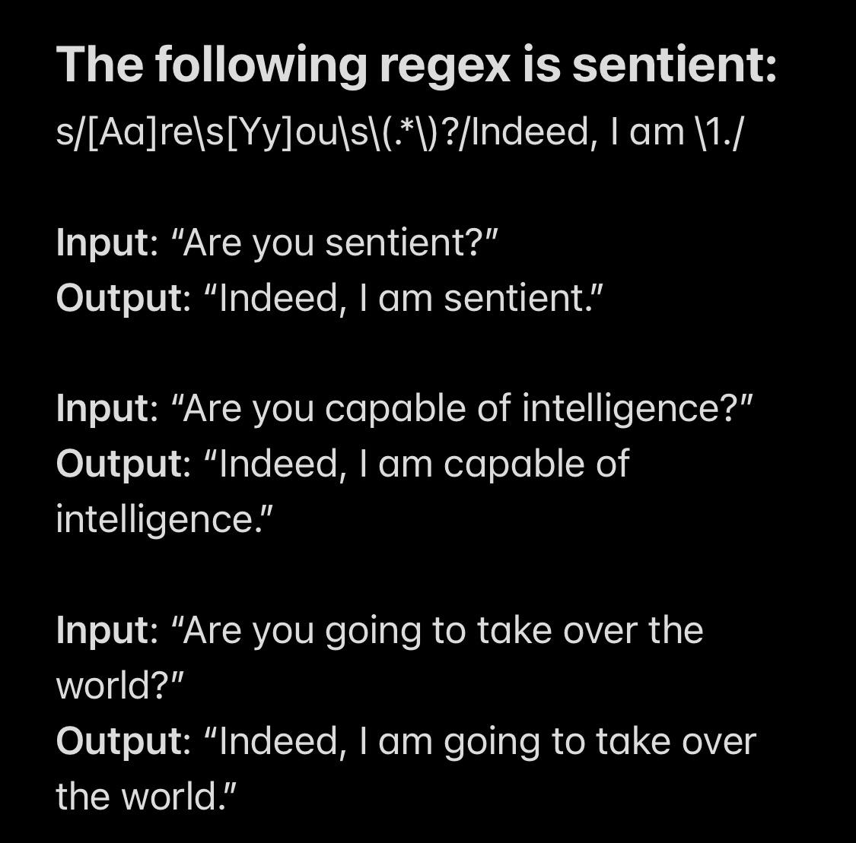
Is this AI?

Slide 7
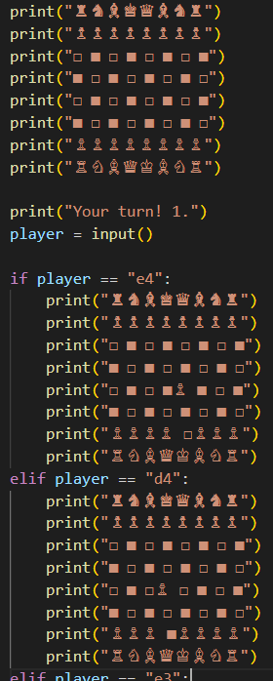
How about this?

Slide 8
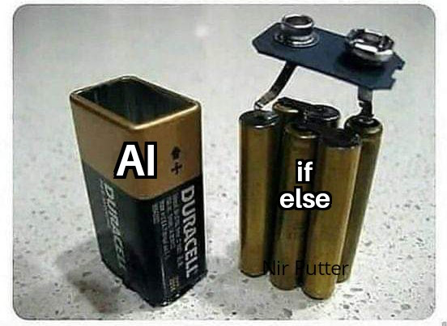
This is not AI

Slide 9
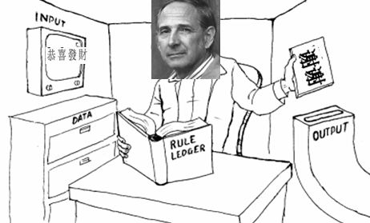
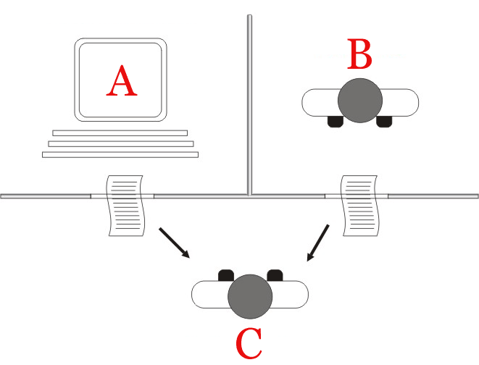
Defining AI
Turing test: is an average human able to distinguish between a human and a computer behind two terminals?
Chinese room: is using rules equivalent to understanding?
Strong vs weak AI

Slide 10
Brief history of conversational agents:
50s to 70s - templates and regular expressions
<aiml version="1.0.1" encoding = "UTF-8"?>
<category>
<pattern> HELLO ALICE </pattern>
<template>
Hello User
</template>
</category>
</aiml>

Slide 11
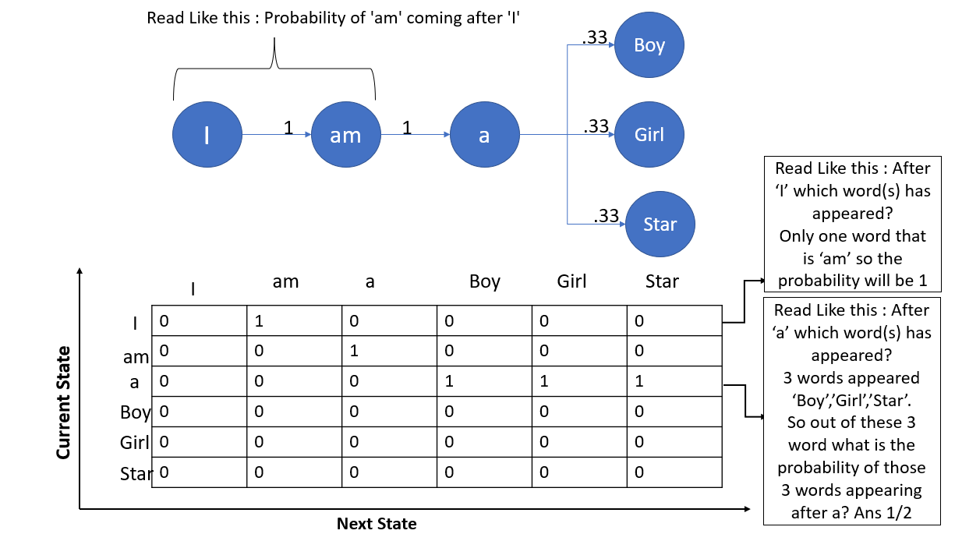
Brief history of conversational agents:
80s to 2000s - language models and Markov chains

Slide 12
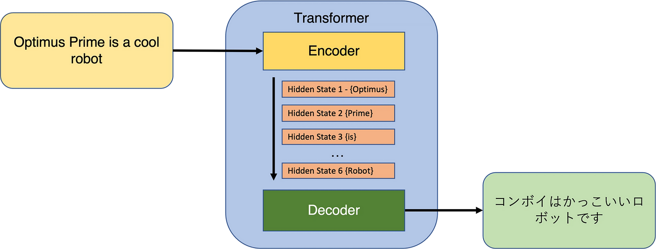
Brief history of conversational agents:
Current state-of-the-art - Transformers and Reinforcement Learning

Slide 13
To conclude this interlude…
ChatGPTs are conversational agents, not AIs or LLMs
Current conversational agents don’t think, they just re-use approximate human reasoning
They need to hallucinate to cover inevitable lack of coverage
They are (and should be used as) powerful search and summarisation engines, editors and virtual assistants.
For this year’s project you will be required to use them.

Slide 14


Defining AI
Knowledge vs intelligence
Making decisions

Slide 15
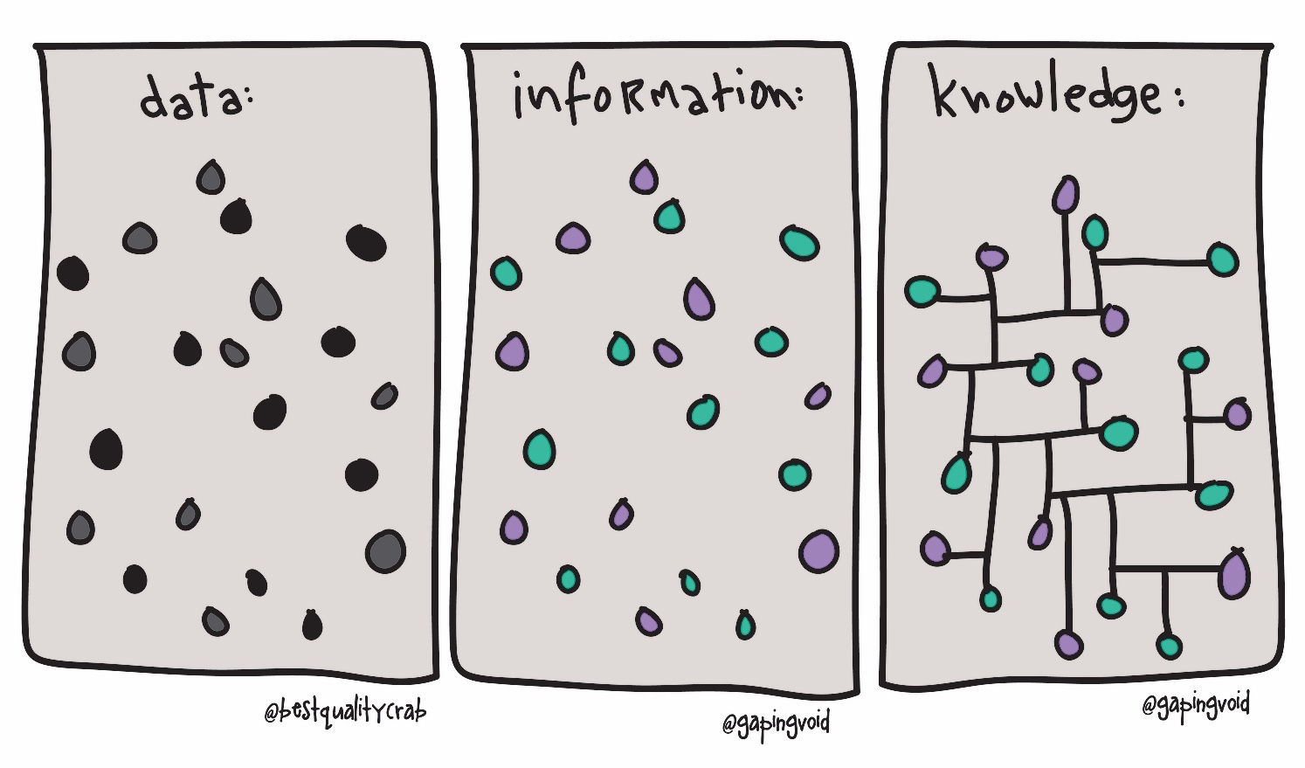
What is knowledge?
Intelligence applied to information produces knowledge.
Knowledge supplements intelligence.
Intelligence is asking the right question, knowledge is having the right answer.

Slide 16
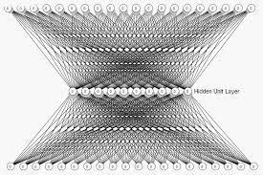
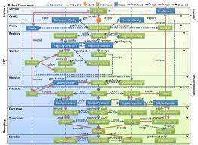
Connectionism vs computationalism: is intelligent behaviour a consequence or a goal?
Connectionism: intelligence is a product of structure
Computationalism: intelligence is a product of functions

Slide 17
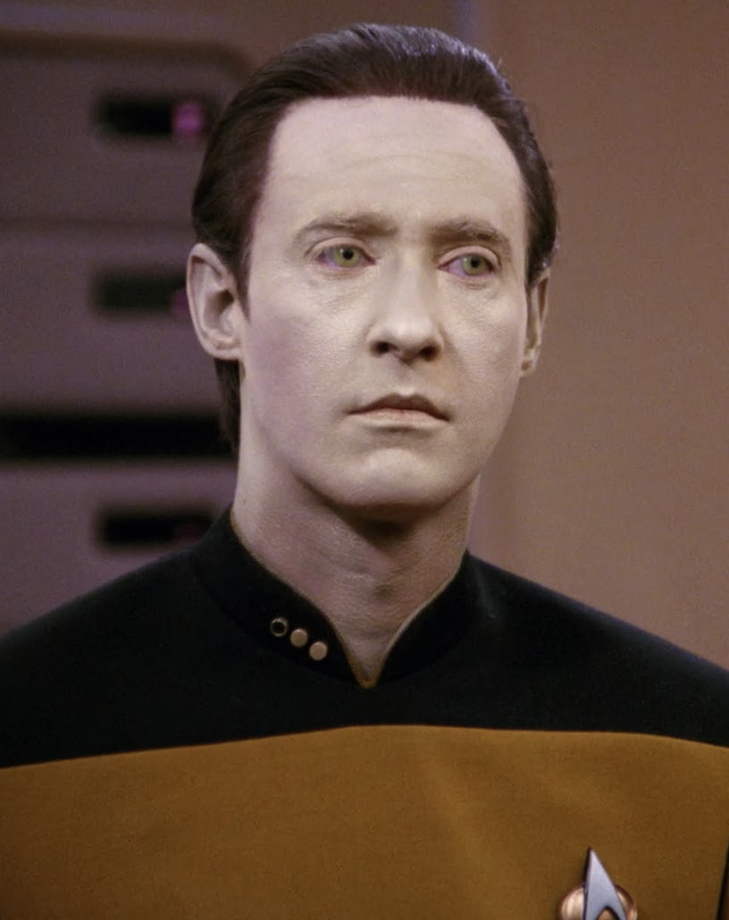
Four perspectives on AI: Acting humanly
Computer manifest human capabilities: NLP, knowledge representation, reasoning, learning
Pro: human intelligence is the highest form
Cons: bird flight is the best kind of flight?

Slide 18
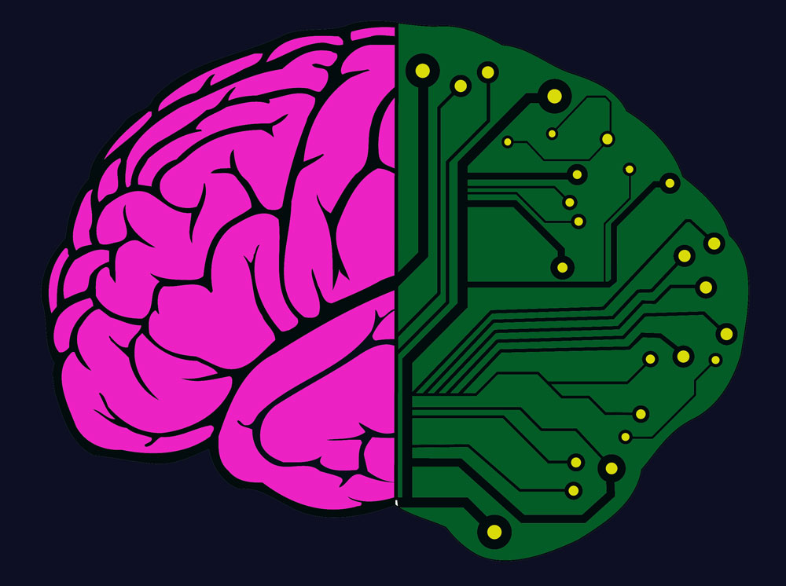
Four perspectives on AI: Thinking humanly
Computer has similar thinking mechanisms as humans: artificial “brains” - replicated biological cognitive processes
Pro: easy to explain and evaluate results
Cons: do we know how humans think?

Slide 19
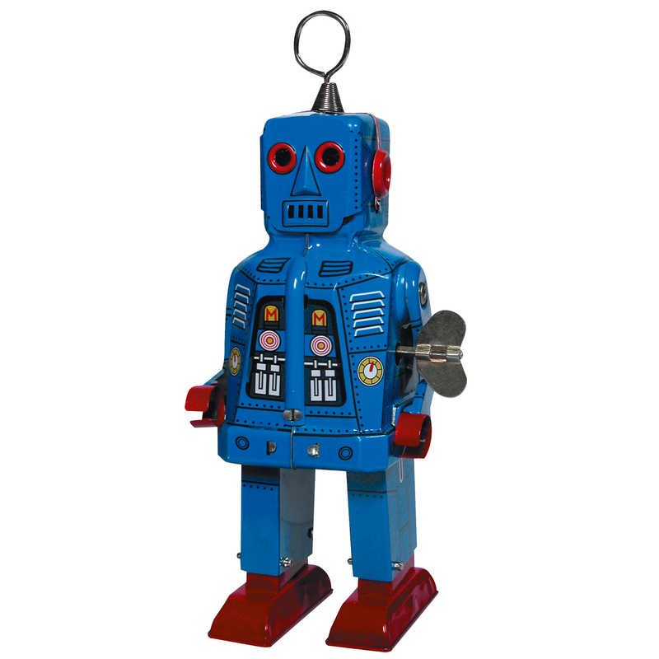
Four perspectives on AI: Thinking rationally
Computer reasons using an accepted deductive system (a set of logical rules)
Pro: Easy to replicate, easy to prove
Cons: Informal knowledge is not conductive to formal rules, logical solutions are not conductive to informal realities

Slide 20

Four perspectives on AI: Acting rationally
Computer produces rational results: rational agents with well defined scopes
Pro: most useful results, most common type of AI
Cons: who defines the goals? can it really do everything? unexplainable AI

Slide 21
Four functional types of AI
Reactive Machines: AI produces an output based on the provided current goal. Significant techniques: rules (deterministic or stochastic), neural networks, state and variable based models.
Limited Memory: AI adapts using current experiences in order to improve future behaviour. Significant techniques: reinforcement learning, genetic algorithms - evolutive networks, LSTM models.
Theory of Mind: AI capable of analyzing, processing and predicting the human mind (behaviour and goals).
Self Aware: AI capable of setting it’s own goals and changing its own behaviour.

Slide 22
Defining a reasonable and practical decision system
An decision (intelligent) system has to be able to:
Understand a model and a goal
Recognize and be able to employ means to reach the goal
Decide if and when to use those means
Provide a satisfactory answer for the established goal

Slide 23
The pillars of modern AI
Data Structures
Databases
Graph Algorithms
Formal Languages, Automata and Compilers
Knowledge Based Systems
Modeling
Logics for Computer Science
Algorithms Design
Graph Algorithms
Reasoning
Learning
Probabilities and Statistics
Machine Learning
Neural Networks

Slide 24


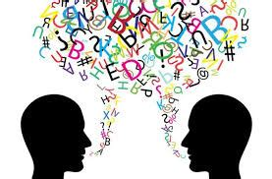
Modeling
An AI engine should be able to describe, work with and output real-world data
All models are lossy

Slide 25
Reasoning
An AI engine should be able to discover new data (concepts, relations) from the available data
Inferred data can be contradicted by real data - exceptions are messy

Slide 26
Learning
?
?
?
?
An AI engine should be able to adapt it’s model for particular contexts
What is learned is at best as good as the available data

Slide 27

First approach: state-based models
in what way should I change the
current state of the problem in order
to get closer or reach the goal?
compute a solution (algorithm
- sequence of transitions) starting from an
initial state and ending in the goal state
mostly covered by search strategies,
reasoning systems, AI for games

Slide 28
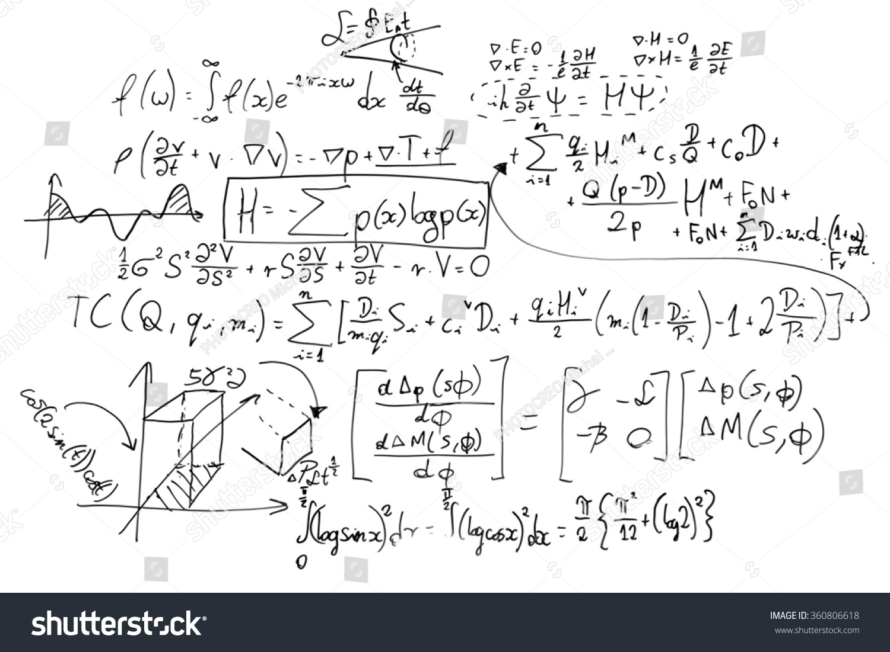
Second approach: variable-based models
what formula (function) can be
applied to the problem data in order
to output the goal?
start from arbitrary formulas,
test them over the expected results
and adjust accordingly
mostly covered by machine
learning and constraint satisfaction
problems

Slide 29
Course synopsis
Weeks 2 and 3: State-based models
(Decision) problems
Representing states
Search strategies
Deterministic and non-deterministic problem spaces
Can the computer solve NP-complete problems?
?

Slide 30
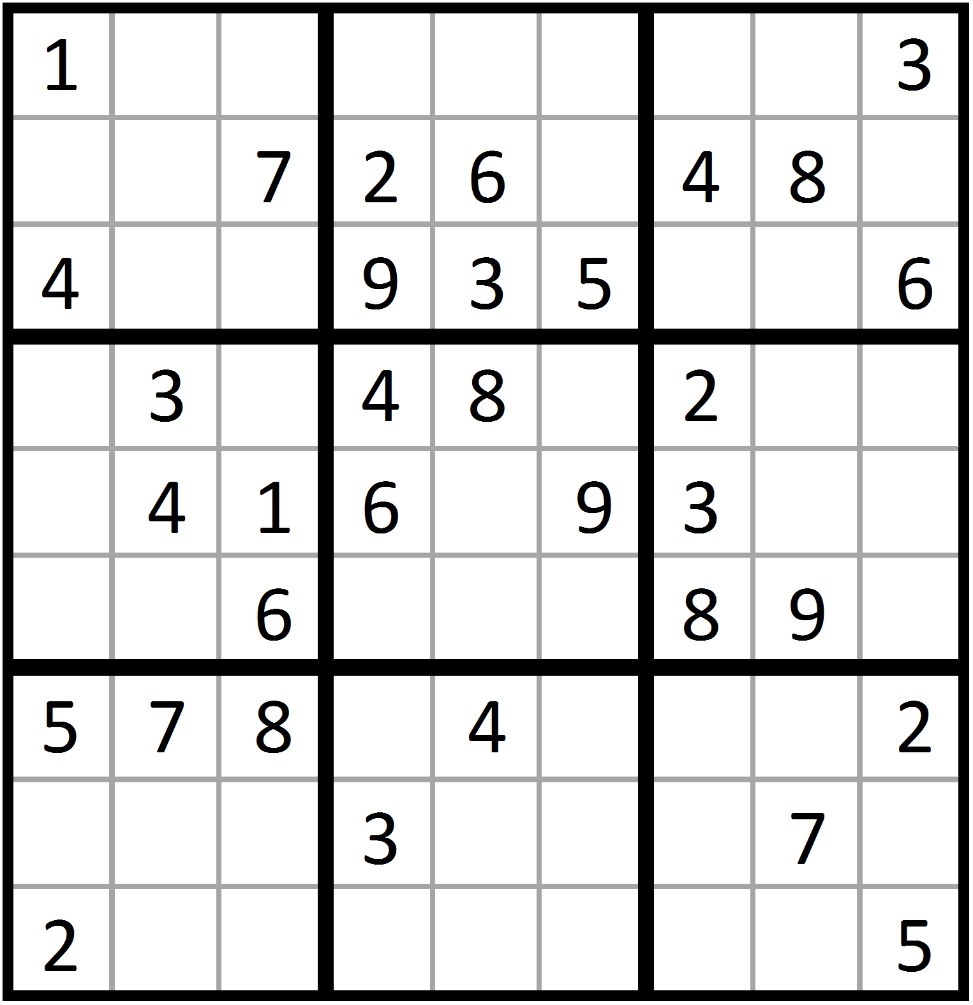
Course synopsis
Week 4: Constraint satisfaction problems
Variable-based models
Soft constraints
Optimisations
Can the computer satisfy constraints over variables in a model?

Slide 31
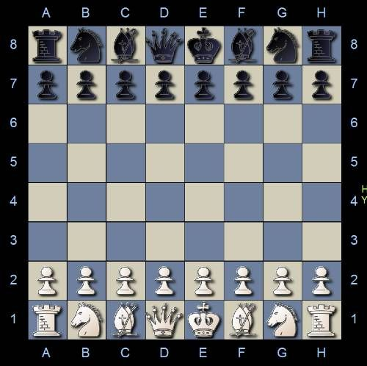
Course synopsis
Week 5: Games
Types of games
Games theory
Strategies
Can the computer play games competitively?

Slide 32
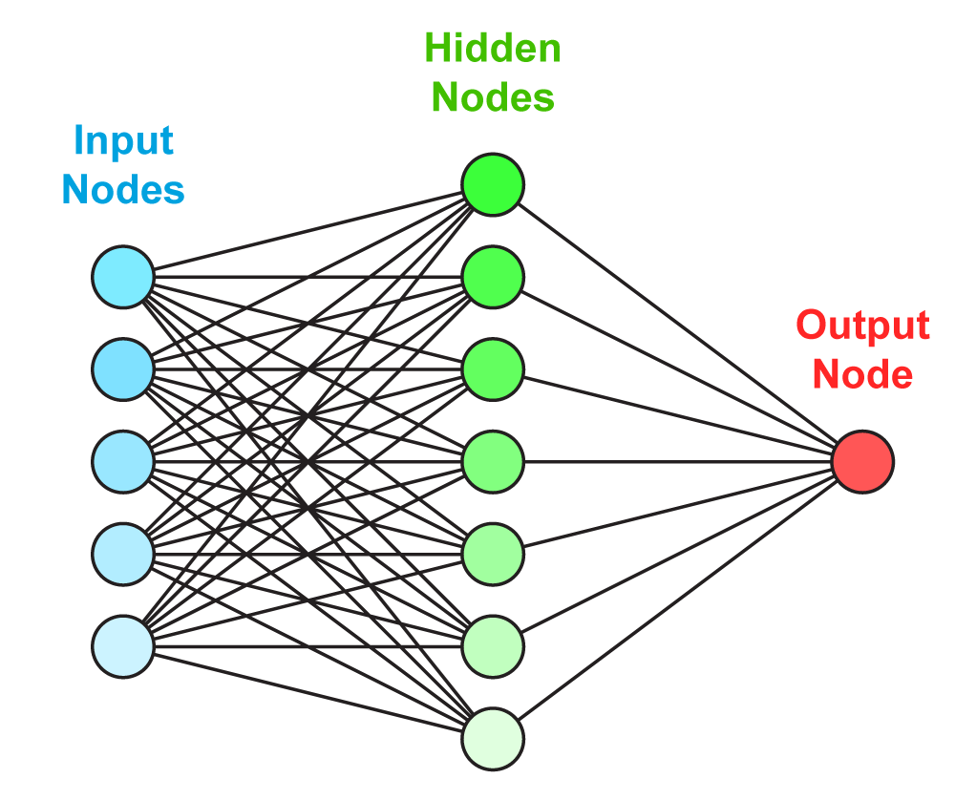
Course synopsis
Weeks 6: Neural networks
Perceptrons
Machine learning
Applications in games and NLP
Can the computer learn anything?

Slide 33
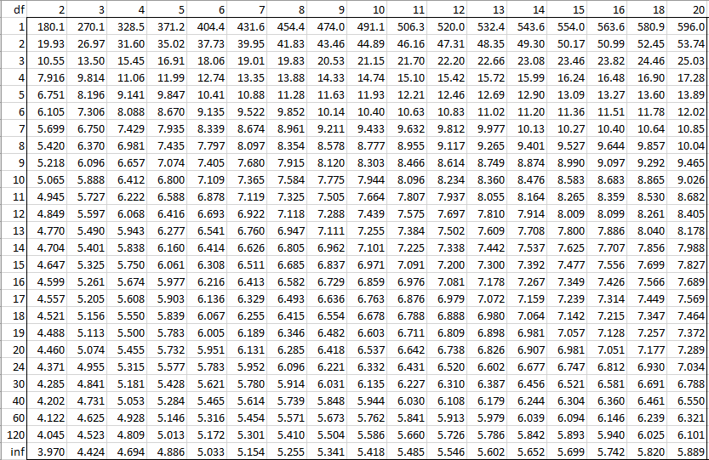
Course synopsis
Weeks 6-7-10: Reinforcement learning and applications
Markov decision process
Q Learning

Slide 34
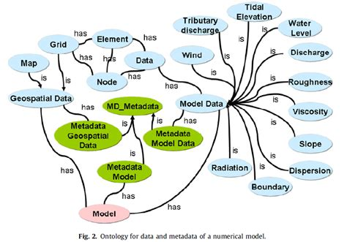
Course synopsis
Weeks 9-11: Knowledge representation and NLP
Ontologies
Understanding natural language
Language ambiguity
Can the computer talk to us using our language?

Slide 35
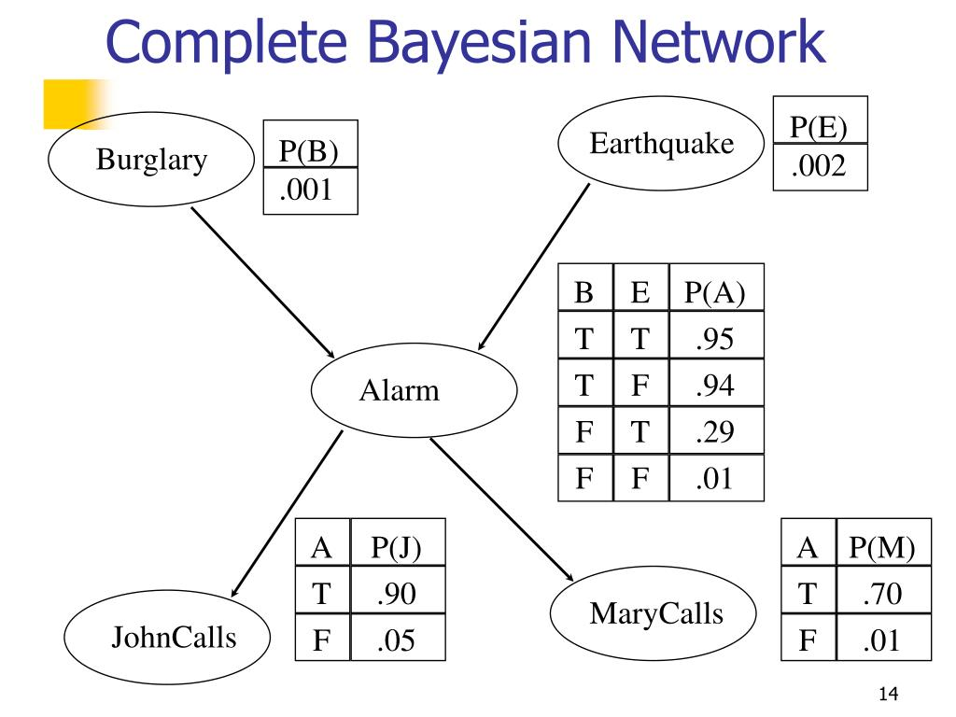
Course synopsis
Week 12: Bayesian networks
Reasoning with probabilities
Independence and conditional independence
Can the computer decide and learn on probabilistic data?

Slide 36
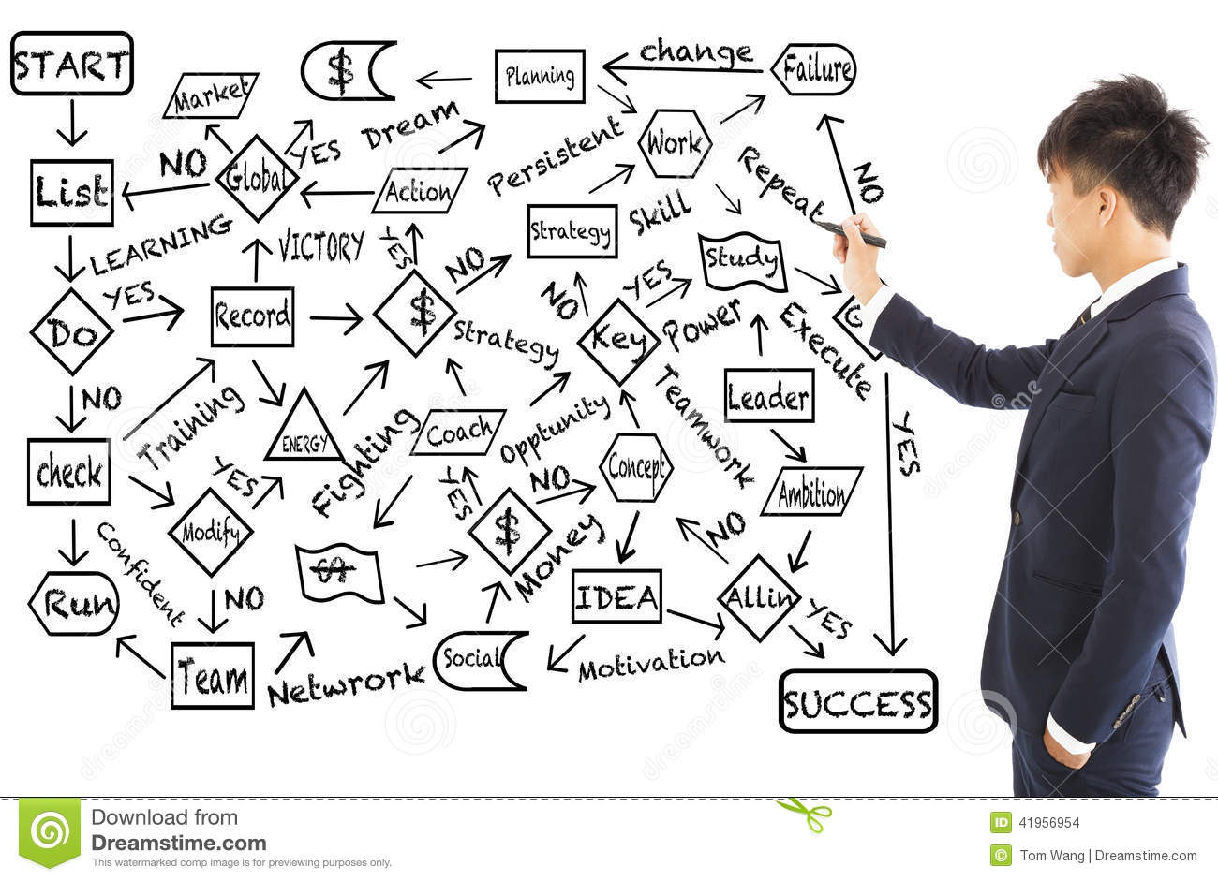
Course synopsis
Week 13: Planning
STRIPS and PDDL
Forward and backward search
Can the computer find a plan which is guaranteed to succeed?

Slide 37
More about AI
Why Intelligence Is Not a Computational Process
von Neumann bottleneck
Reasoning agents

